Slide 1

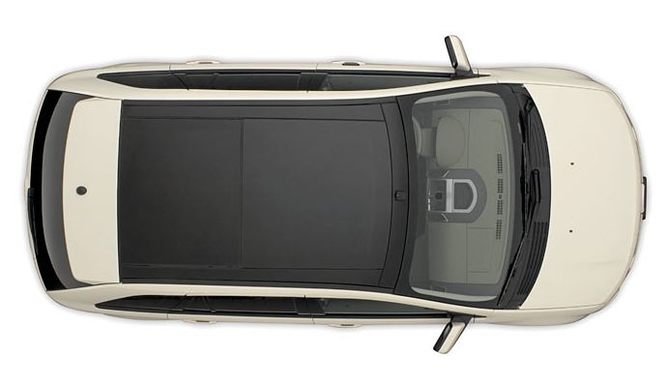
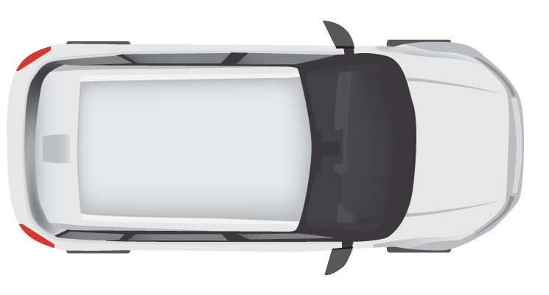
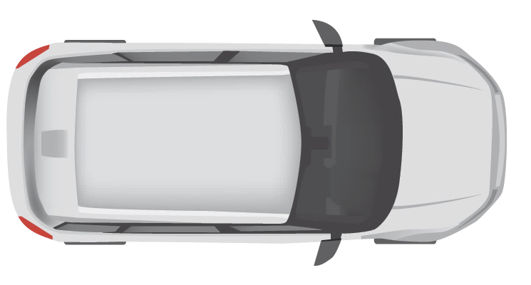
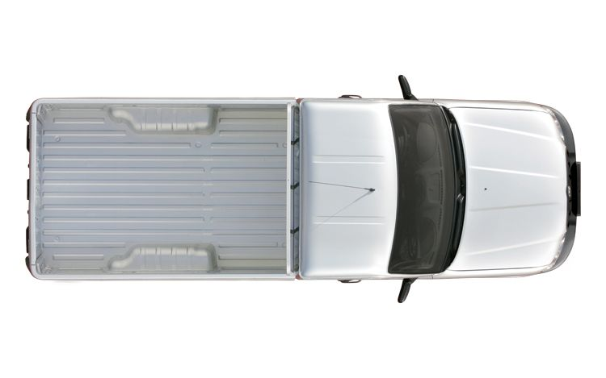


10 km
Entry Cam 1
Exit Cam 1
Entry Cam 2
Exit Cam 2
Entry Cam 3
Exit Cam 3

Slide 2
Simulation
TrafficControl
Service
Government
Service
EntryCam
RDW
ExitCam
CJIB

Slide 3
TrafficControl Service
Government Service
Simulation
Entry Cam
Exit Cam
RDW
CJIB
State
Store
VehicleRegistered
GetVehicleInfo
Store VehicleState
VehicleRegistered
Get VehicleState
Calculate Average Speed
[AvgSpeedOverLimit]
SpeedingViolationDetected
Calculate Fine
Send Speeding Ticket

Slide 4


3
Sidecar
TrafficControl
Service
EntryCam
ExitCam
Simulation
Sidecar
Reddis
1
2
Sidecar
Government
Service
RDW
CJIB
1
Pub/Sub
Service Invocation
3
State Management
2

Slide 5
1
Sidecar
Application B
3
Application A
Sidecar
2
Reddis
1
Sidecar
Application C
3

